Slide 1
Introduction to Containers
Levi Hinze
Notes:
My name is Levi Hinze.
I am the architect for Jurisdiction Online, an Aptean company.
I am a husband and father of two boys.
DISCLAIMER: Not an expert on containers.

Slide 2
What is a container?
Notes:
Ask audience what is a container.
A container image is a lightweight, stand-alone, executable package of a piece of software that includes everything needed to run it: code, runtime, system tools, system libraries, settings. Available for both Linux and Windows based apps, containerized software will always run the same, regardless of the environment. Containers isolate software from its surroundings, for example differences between development and staging environments and help reduce conflicts between teams running different software on the same infrastructure.
Docker is just one container runtime. There are others such as rkt and containerd.

Slide 3
History
Functionality from Unix/Unix-like operating systems to segregate processes
Gradually started to gain traction as vendors started to add more features
Docker started in 2013
Notes:
1979: Unix V7 – chroot – Change root directory of a process and its children. The process cannot access files outside of the designated directory tree.
2000: FreeBSD Jails – Partitioned a FreeBSD computer system into several independent, smaller systems with ability to assign an IP address for each system and configuration.
2001: Linux VServer – Similar to FreeBSD Jails
2004: Oracle Solaris Containers – Combined system resource controls (such as RAM, CPU, etc) and boundary separation.
2006: Process Containers – Launched by Google that supported limiting, accouting, and isolating resource usage of a collection of processes. Renamed Control Groups and eventually merged into Linux kernel.
2008: LXC – First most complete implementation of Linux container manager using cgroups and Linux namespaces.

Slide 4
Why use a container?
Notes:
Mentioned earlier about benefits when we described what a container was; portability, isolation, and scalability.
Container sizes tend to be smaller than VMs.
Containers tend to be less resource intensive than running VMs.
Provisioned quickly to handle spike loads.
Support the same mindset for developing microservices.

Slide 5
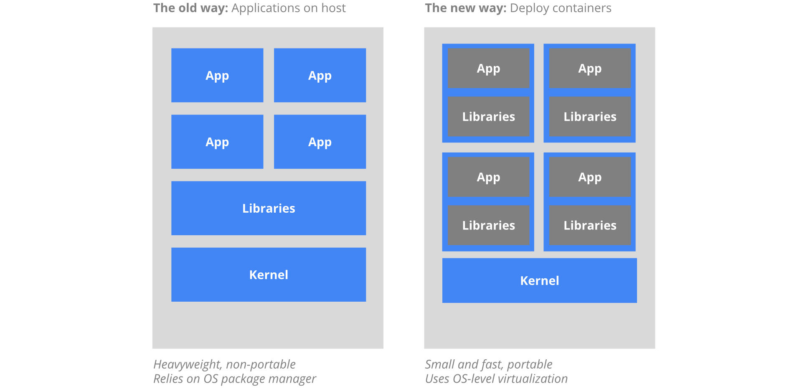

Slide 6
Why not to use a container?
Notes:
Ask why we shouldn’t use a container.

Slide 7
Security
Linux or Windows, but not both
Database
Notes:
Docker containers have root access, so can be a security issue. If someone breaks out of the container, they would have root access to the system. Some other container runtimes, such as rkt, do not require root access.
Although it is currently in the works, you cannot mix Windows and Linux container side by side on a single machine. There is work to run both on Windows, and also in cloud container PaaS solutions such as Amazon ECS and Azure AKS.
You can run some databases in a container, such as MySQL and SQL Server 2017, it is still considered bad practice to run your production database in a container. There are some really smart people working on this to attempt to make it better.

Slide 8
demo
Notes:
Show simple Node application and run
Use VSCode to setup Docker files
Setup the launch profile
Debug the container
Talk about difference between dockerfile and docker-compose
dockerfile contains commands a user could call to assemble an image
Docker-compose – defines your service in it’s running state. Can be used to define multiple services/containers that make up your app

Slide 9
More complicated scenarios
Notes:
What about more complicated applications that have multiple applications that need to communicate with each other?
What about service discovery when you run multiple instances of a container? Or load balancing?
What about monitoring the containers?
What about handling secrets for the containers, such as database connection strings?
What if you need to start or stop containers based off events or schedules?

Slide 10
Container orchestrators
kubernetes
Docker swarm
Cloud solutions
Amazon Elastic Container Service (ECS)
Azure Kubernetes Service (AKS) – Preview
Amazon Elastic Container Service for Kubernetes (EKS) - Preview

Slide 11
Questions?

